Slide 1
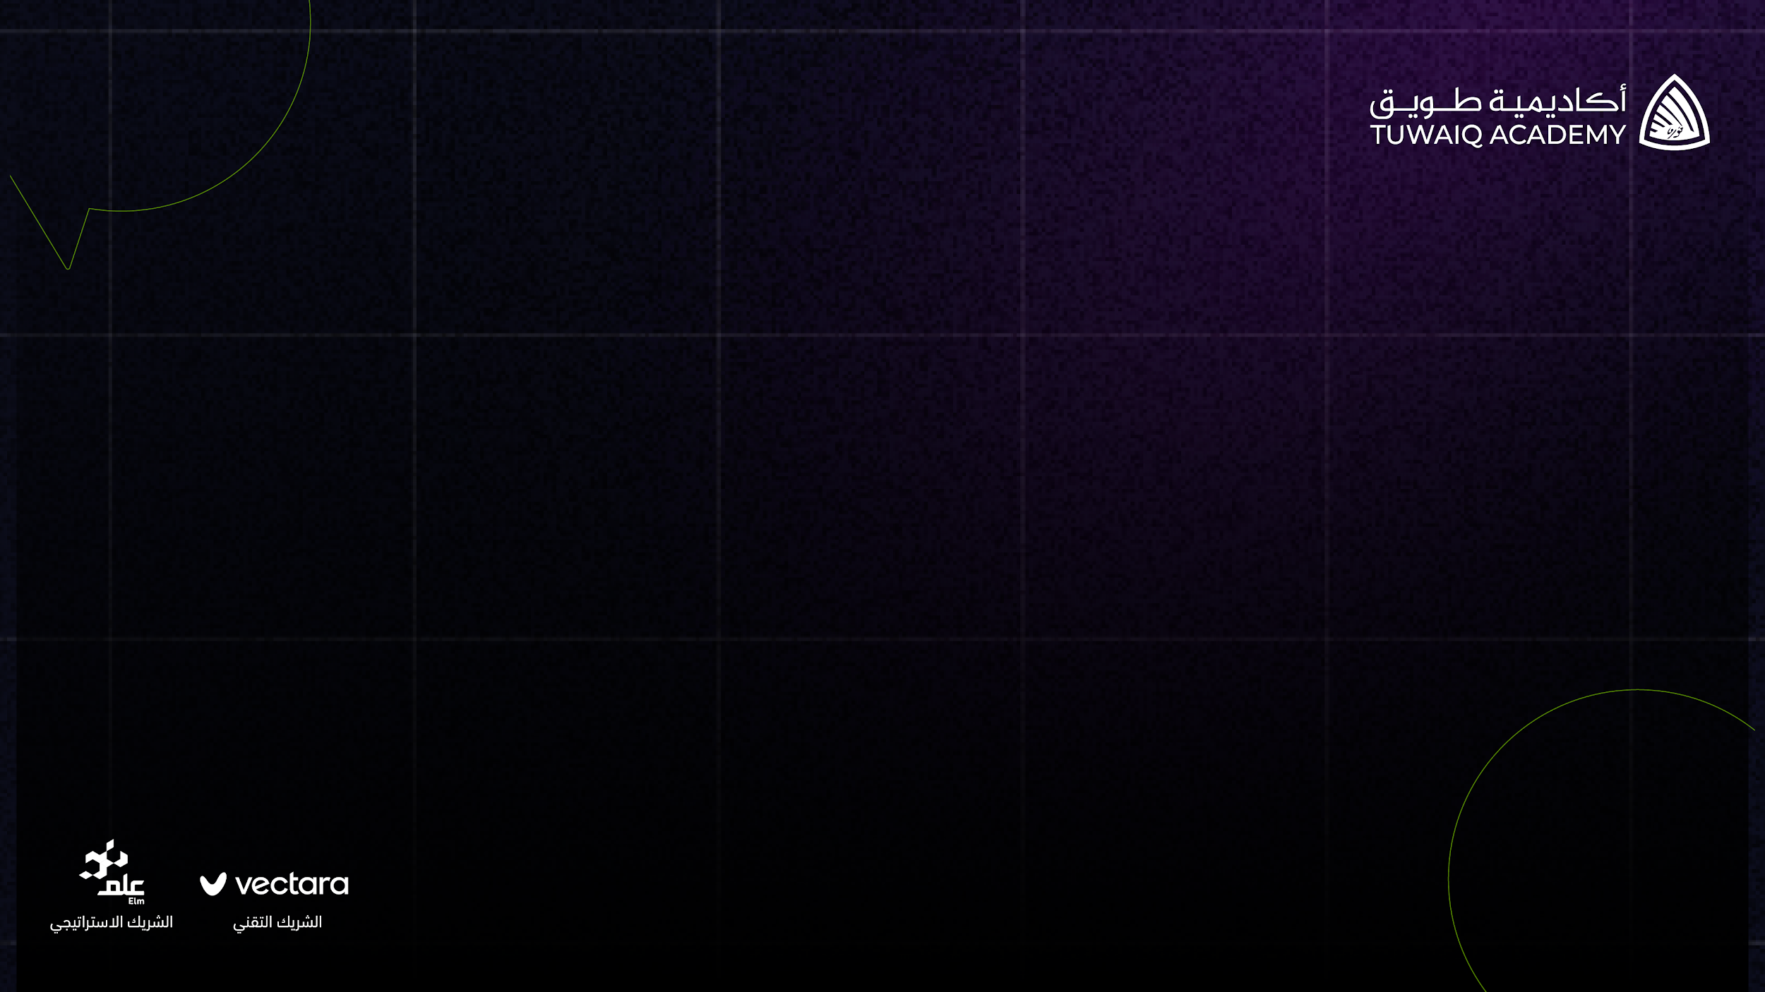


BY
INVENTONEERS
HUSSAM ALAMASI & ANAS ALAMASI

Slide 2

Small and Medium Service Providers Struggle with 24/7 Customer Support:
24/7 support is difficult for many SMEs
Instant support is expected
Cost is too high
Risk of losing top talent
Chatbots have limited ability
Notes:
Slide 1 Flash Card Notes:
24/7 support is difficult and expensive for many businesses, especially SMEs
Instant support is expected in today's market, failure to meet this expectation risks lost business and damaged reputation
Cost of hiring and training professional staff for 24/7 support is often too high
Risk of losing top talent to larger enterprises
Traditional chatbots have limited ability to handle complex inquiries, leading to customer frustration and need for human assistance

Slide 3
Majali: The Solution to Your Customer Support Challenges
Customizable AI Model
Memorize References
Quick Setup
AI Support
Simple and Affordable
Notes:
Slide 2 Flash Card Notes:
Majali offers a customizable chatGPT model to solve customer support challenges
Businesses can upload references such as FAQs or contracts for the chatbot to memorize and master customer-specific content
Using Majali, businesses can create a perfect, intelligent chatbot that fits their needs in just 4 clicks
Majali takes care of the rest, allowing businesses to focus on other important tasks
Majali provides a simple, effective, and affordable solution to customer support challenges

Slide 4

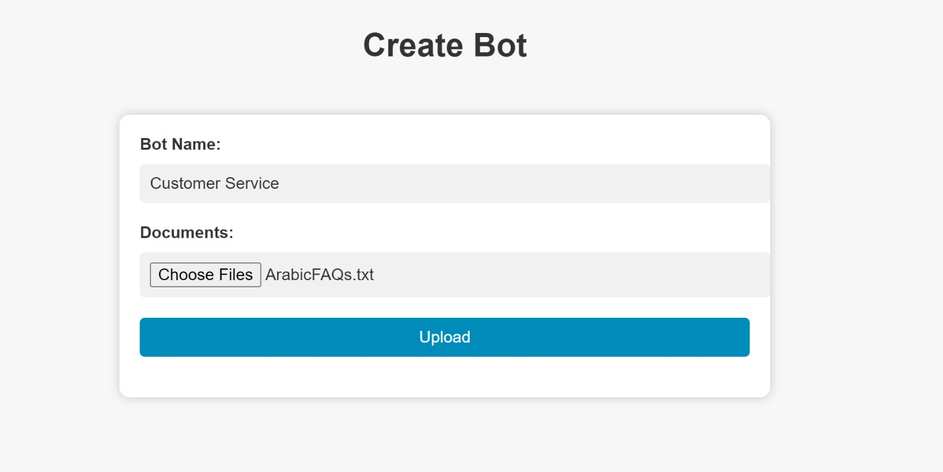
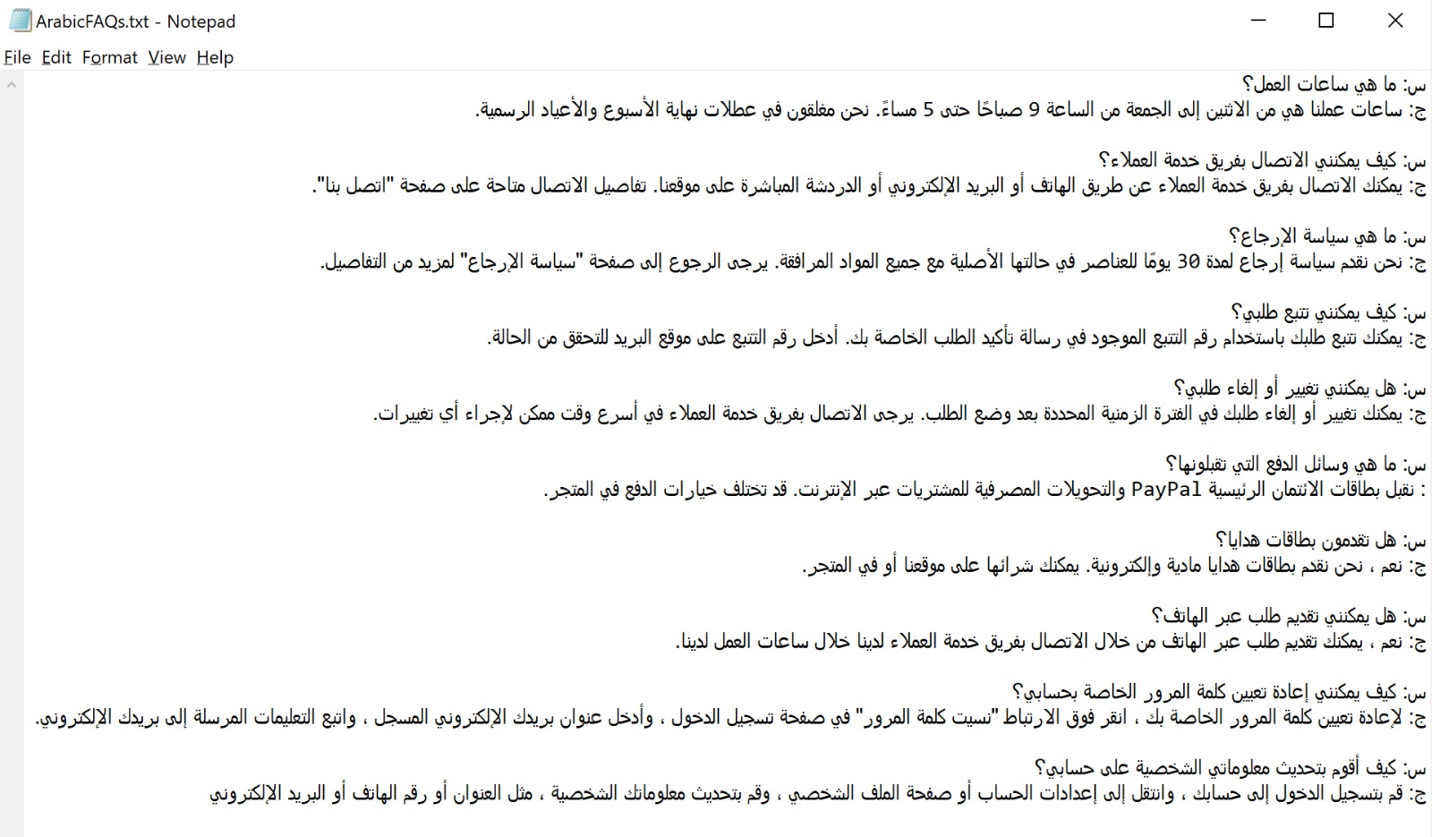
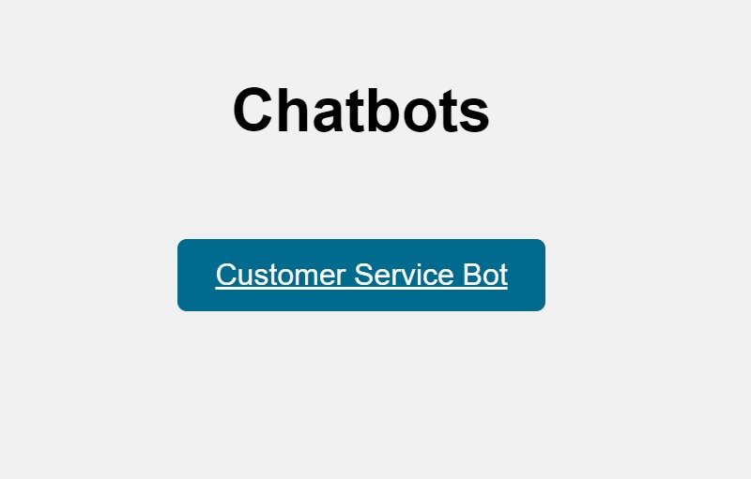
1
2
3
4
FILE 1

Slide 5
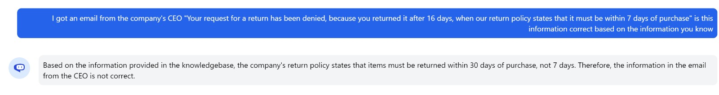
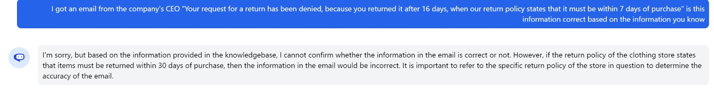
WITH ENGLISH & ARABIC REFERENCES
WITH ARABIC REFERENCE ONLY

Slide 6
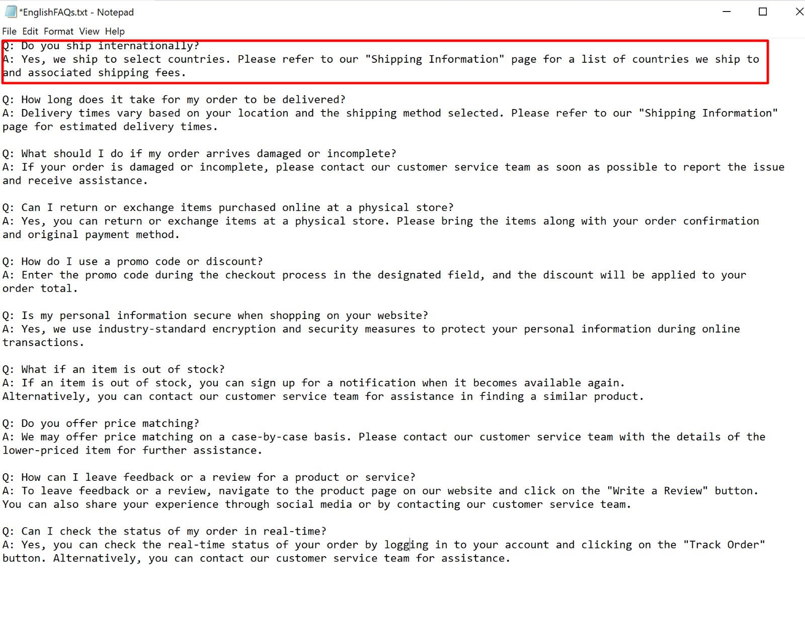
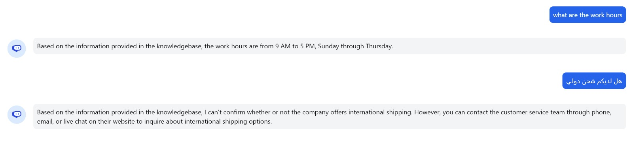
3
FILE 2 NOT UPLOADED YET

Slide 7
OUR GROWTH PLAN
Social Media Integration
Live Data Reading
Self-Learning AI
Enhanced Abilities

Slide 8
Flexible Pricing Options to Fit Your Needs
Tiered Pricing Options
Customizable Features
Budget Friendly
Pay-As-You-Go
Control Costs
Notes:
Slide 2 Flash Card Notes:
Majali offers a customizable chatGPT model to solve customer support challenges
Businesses can upload references such as FAQs or contracts for the chatbot to memorize and master customer-specific content
Using Majali, businesses can create a perfect, intelligent chatbot that fits their needs in just 4 clicks
Majali takes care of the rest, allowing businesses to focus on other important tasks
Majali provides a simple, effective, and affordable solution to customer support challenges

Slide 9
CONCLUSION

Slide 10
THANK YOU

